Slide 1
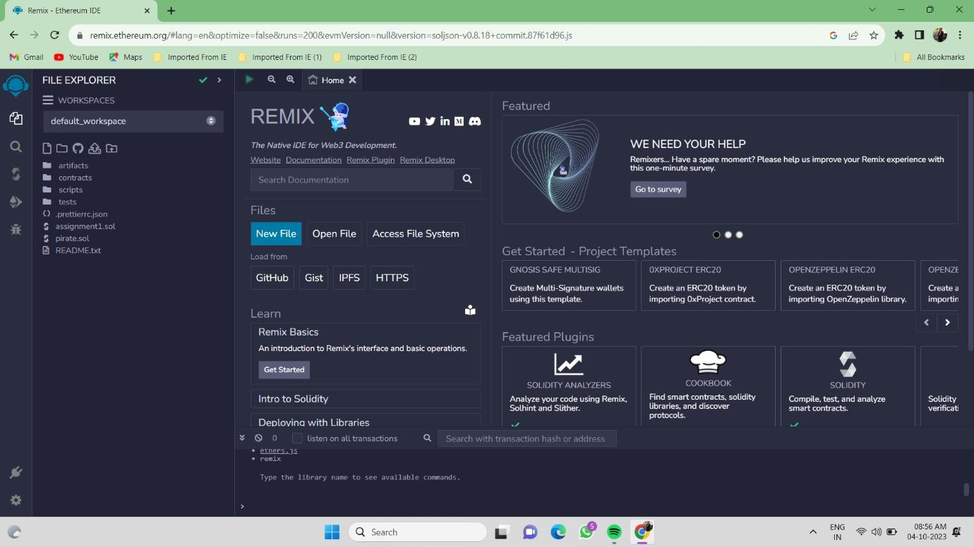
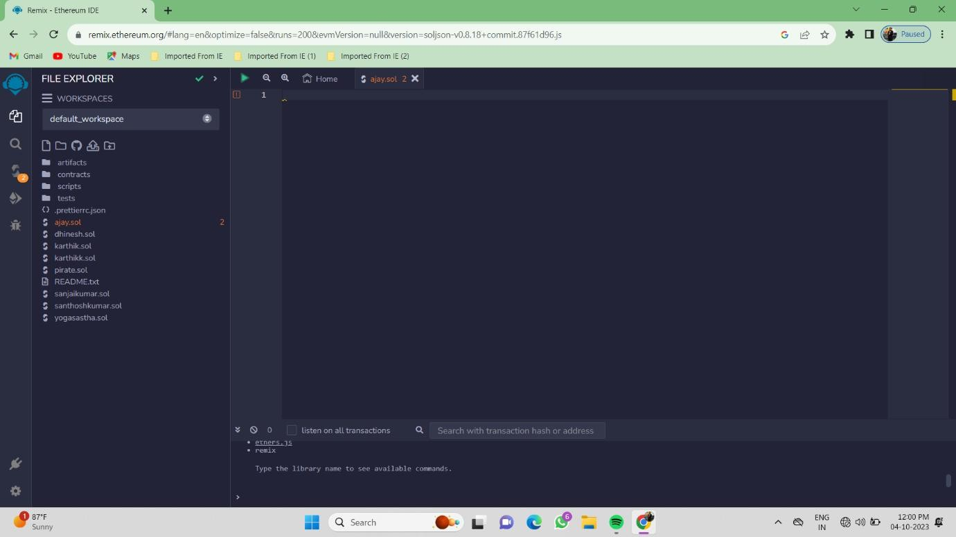
Blockchain Technology Assignment 1
1. Open remix platform
2. Creating a New File

Slide 2
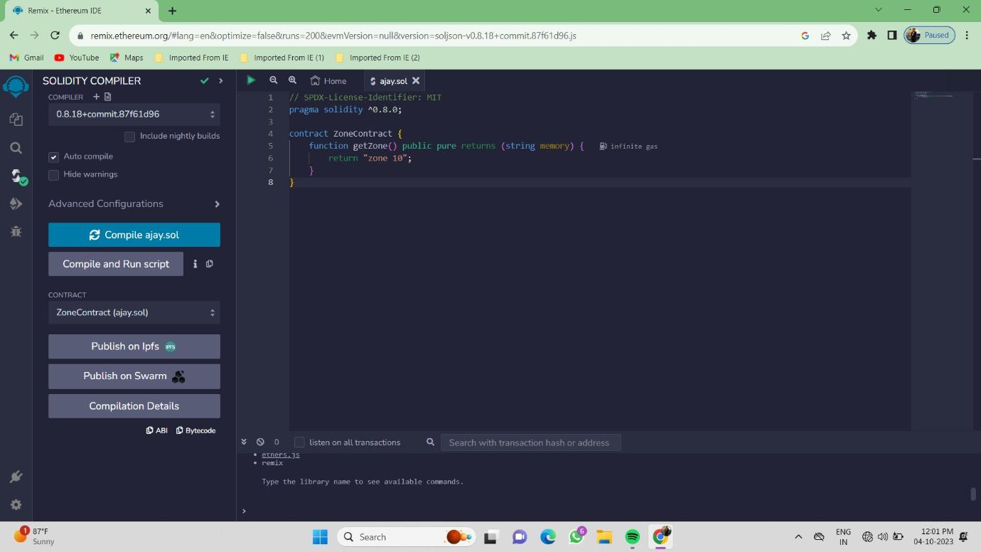
3. Program To Return String
4. ABI :
[
{
"inputs": [],
"name": "getZone", "outputs": [
{
"internalType": "string", "name": "",
"type": "string"
}
],
"stateMutability": "pure", "type": "function"
}
]

Slide 3

Only two pages were converted.
Please Sign Up to convert the full document.
www.freepdfconvert.com/membership

